Slide 1

Maps
Chris Piech
CS106A, Stanford University

Slide 2
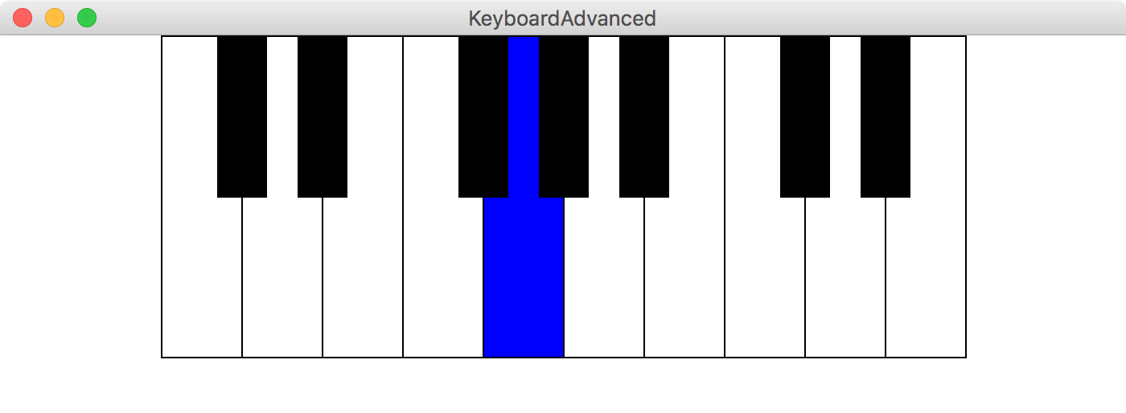
Make a keyboard

Slide 3
Where are we?

Slide 4
Where are we?
Karel the Robot
Java
Console Programs
Graphics Programs
Text Processing
Data Structures
GUIs
Defining our own Variable Types

Slide 5
Collections High Level
List:
ArrayList<type>
Array:
type[]
Matrix:
type[][]

Slide 6
Collections High Level
List:
ArrayList<String>
Array:
double[]
Matrix:
int[][]

Slide 7
ArrayList
index -> value

Slide 8
Arrays
index -> value

Slide 9
Matrix
(row, col) -> value

Slide 10
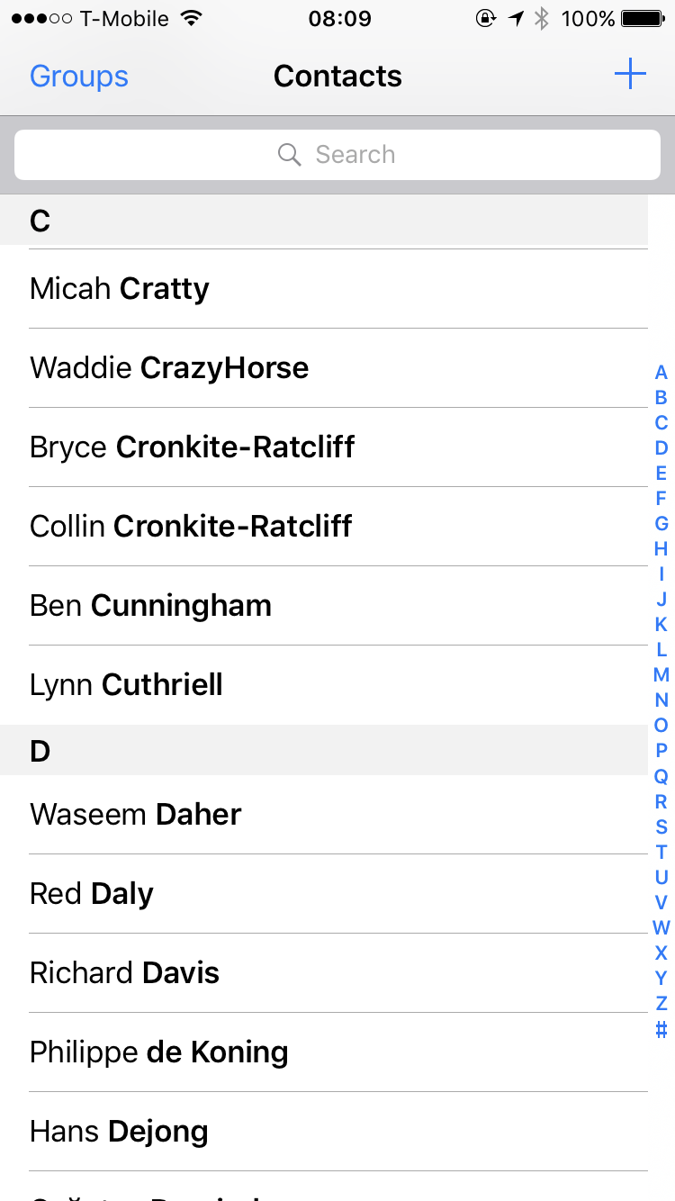

Maps can have any type for key
Many examples

Slide 11
HashMap
key -> value

Slide 12
Simple Example
Make a new HashMap of animal sounds
2. Add elements:
Put [key = “dog”, value = “bark”]
Put [key=“cat”, value=“meow”]
Put [key=“seal”, value=“ow ow ow”]
3. Get elements:
Get [key = “dog”]

Slide 13
Simple Example
Make a new HashMap of animal sounds
2. Add elements:
Put [key = “dog”, value = “bark”]
Put [key=“cat”, value=“meow”]
Put [key=“seal”, value=“ow ow ow”]
3. Get elements:
Get [key = “dog”]

Slide 14
Simple Example
animalSoundMap
Values:
Keys:
Make a new HashMap of animal sounds
2. Add elements:
Put [key = “dog”, value = “bark”]
Put [key=“cat”, value=“meow”]
Put [key=“seal”, value=“ow ow ow”]
3. Get elements:
Get [key = “dog”]

Slide 15
Simple Example
animalSoundMap
Values:
Keys:
Make a new HashMap of animal sounds
2. Add elements:
Put [key = “dog”, value = “bark”]
Put [key=“cat”, value=“meow”]
Put [key=“seal”, value=“ow ow ow”]
3. Get elements:
Get [key = “dog”]

Slide 16
Simple Example
animalSoundMap
Values:
“bark”
Keys:
“dog”
Make a new HashMap of animal sounds
2. Add elements:
Put [key = “dog”, value = “bark”]
Put [key=“cat”, value=“meow”]
Put [key=“seal”, value=“ow ow ow”]
3. Get elements:
Get [key = “dog”]

Slide 17
Simple Example
animalSoundMap
Values:
“bark”
Keys:
“dog”
Make a new HashMap of animal sounds
2. Add elements:
Put [key = “dog”, value = “bark”]
Put [key=“cat”, value=“meow”]
Put [key=“seal”, value=“ow ow ow”]
3. Get elements:
Get [key = “dog”]

Slide 18
Simple Example
animalSoundMap
Values:
“bark”
“meow”
Keys:
“dog”
“cat”
Make a new HashMap of animal sounds
2. Add elements:
Put [key = “dog”, value = “bark”]
Put [key=“cat”, value=“meow”]
Put [key=“seal”, value=“ow ow ow”]
3. Get elements:
Get [key = “dog”]

Slide 19
Simple Example
animalSoundMap
Values:
“bark”
“meow”
Keys:
“dog”
“cat”
Make a new HashMap of animal sounds
2. Add elements:
Put [key = “dog”, value = “bark”]
Put [key=“cat”, value=“meow”]
Put [key=“seal”, value=“ow ow ow”]
3. Get elements:
Get [key = “dog”]

Slide 20
Simple Example
animalSoundMap
“ow
ow
ow”
Values:
“bark”
“meow”
Keys:
“dog”
“seal”
“cat”
Make a new HashMap of animal sounds
2. Add elements:
Put [key = “dog”, value = “bark”]
Put [key=“cat”, value=“meow”]
Put [key=“seal”, value=“ow ow ow”]
3. Get elements:
Get [key = “dog”]

Slide 21
Simple Example
animalSoundMap
“ow
ow
ow”
Values:
“bark”
“meow”
Keys:
“dog”
“seal”
“cat”
Make a new HashMap of animal sounds
2. Add elements:
Put [key = “dog”, value = “bark”]
Put [key=“cat”, value=“meow”]
Put [key=“seal”, value=“ow ow ow”]
3. Get elements:
Get [key = “dog”]

Slide 22
Simple Example
animalSoundMap
“ow
ow
ow”
Values:
“bark”
“meow”
Keys:
“dog”
“seal”
“cat”
Make a new HashMap of animal sounds
2. Add elements:
Put [key = “dog”, value = “bark”]
Put [key=“cat”, value=“meow”]
Put [key=“seal”, value=“ow ow ow”]
3. Get elements:
Get [key = “dog”]

Slide 23
Simple Example
animalSoundMap
“ow
ow
ow”
Values:
“bark”
“meow”
Keys:
“dog”
“seal”
“cat”
Make a new HashMap of animal sound
2. Add elements:
Put [key = “dog”, value = “bark”]
Put [key=“cat”, value=“meow”]
Put [key=“seal”, value=“ow ow ow”]
3. Get elements:
Get [key = “dog”]

Slide 24
Simple Example
animalSoundMap
“ow
ow
ow”
Values:
“bark”
“meow”
Keys:
“dog”
“seal”
“cat”
Make a new HashMap of animal sound
2. Add elements:
Put [key = “dog”, value = “bark”]
Put [key=“cat”, value=“meow”]
Put [key=“seal”, value=“ow ow ow”]
3. Get elements:
Get [key = “cat”]

Slide 25
Simple Example
animalSoundMap
“ow
ow
ow”
Values:
“bark”
“meow”
Keys:
“dog”
“seal”
“cat”
Make a new HashMap of animal sound
2. Add elements:
Put [key = “dog”, value = “bark”]
Put [key=“cat”, value=“meow”]
Put [key=“seal”, value=“ow ow ow”]
3. Get elements:
Get [key = “cat”]

Slide 26
Simple Example
animalSoundMap
“ow
ow
ow”
Values:
“bark”
“meow”
Keys:
“dog”
“seal”
“cat”
Make a new HashMap of animal sound
2. Add elements:
Put [key = “dog”, value = “bark”]
Put [key=“cat”, value=“meow”]
Put [key=“seal”, value=“ow ow ow”]
3. Get elements:
Get [key = “cat”]

Slide 27
My First Map
HashMap<String, String> animalSoundMap =
new HashMap<String, String>();

Slide 28
My First Map
Key Type
Value Type
HashMap<String, String> animalSoundMap =
new HashMap<String, String>();

Slide 29
My First Map
HashMap<String, String> animalSoundMap =
new HashMap<String, String>();

Slide 30
My First Map
HashMap<String, String> animalSoundMap =
new HashMap<String, String>();

Slide 31
My First Map
HashMap<String, String> animalSoundMap =
new HashMap<String, String>();
animalSoundMap.put(“dog”, “bark”);

Slide 32
My First Map
HashMap<String, String> animalSoundMap =
new HashMap<String, String>();
animalSoundMap.put(“dog”, “bark”);

Slide 33
My First Map
HashMap<String, String> animalSoundMap =
new HashMap<String, String>();
animalSoundMap.put(“dog”, “bark”);

Slide 34
My First Map
HashMap<String, String> animalSoundMap =
new HashMap<String, String>();
animalSoundMap.put(“dog”, “bark”);

Slide 35
My First Map
HashMap<String, String> animalSoundMap =
new HashMap<String, String>();
animalSoundMap.put(“dog”, “bark”);
animalSoundMap.get(“dog”);

Slide 36
My First Map
HashMap<String, String> animalSoundMap =
new HashMap<String, String>();
animalSoundMap.put(“dog”, “bark”);
animalSoundMap.get(“dog”);

Slide 37
My First Map
HashMap<String, String> animalSoundMap =
new HashMap<String, String>();
animalSoundMap.put(“dog”, “bark”);
animalSoundMap.get(“dog”);

Slide 38
My First Map
animalSoundMap
“ow
ow
ow”
Values:
“bark”
“meow”
Keys:
“dog”
“seal”
“cat”
Make a new HashMap of animal sound
2. Add elements:
Put [key = “dog”, value = “bark”]
Put [key=“cat”, value=“meow”]
Put [key=“seal”, value=“ow ow ow”]
3. Get elements:
Get [key = “dog”]

Slide 39
My First Map
animalSoundMap
“ow
ow
ow”
Values:
“bark”
“meow”
Keys:
“dog”
“seal”
“cat”
// 1. Make a new map
HashMap<String, String> animalSoundMap =
new HashMap<String, String>();
// 2. Put things into the map
animalSoundMap.put("dog", "woof");
animalSoundMap.put("cat", "meow");
animalSoundMap.put("seal", "ow ow ow");
// 3. Get things out of the map
animalSoundMap.get("dog"); // "woof”

Slide 40
My First Map
animalSoundMap
“ow
ow
ow”
Values:
“bark”
“meow”
Keys:
“dog”
“seal”
“cat”
// 1. Make a new map
HashMap<String, String> animalSoundMap =
new HashMap<String, String>();
// 2. Put things into the map
animalSoundMap.put("dog", "woof");
animalSoundMap.put("cat", "meow");
animalSoundMap.put("seal", "ow ow ow");
// 3. Get things out of the map
animalSoundMap.get("dog"); // "woof"
animalSoundMap.get("fox"); // ?

Slide 41
brothers Vegard
and Bård Ylvisåker
Circa 2013

Slide 42

Ylvis – “The Fox”. Permission asked. Pending.

Slide 43
My First Map
animalSoundMap
“ow
ow
ow”
Values:
“bark”
“meow”
Keys:
“dog”
“seal”
“cat”
// 1. Make a new map
HashMap<String, String> animalSoundMap =
new HashMap<String, String>();
// 2. Put things into the map
animalSoundMap.put("dog", "woof");
animalSoundMap.put("cat", "meow");
animalSoundMap.put("seal", "ow ow ow");
// 3. Get things out of the map
animalSoundMap.get("dog"); // "woof"
animalSoundMap.get("fox"); // ?

Slide 44
My First Map
animalSoundMap
“ow
ow
ow”
Values:
“bark”
“meow”
Keys:
“dog”
“seal”
“cat”
// 1. Make a new map
HashMap<String, String> animalSoundMap =
new HashMap<String, String>();
// 2. Put things into the map
animalSoundMap.put("dog", "woof");
animalSoundMap.put("cat", "meow");
animalSoundMap.put("seal", "ow ow ow");
// 3. Get things out of the map
animalSoundMap.get("dog"); // "woof"
animalSoundMap.get("fox"); // null

Slide 45
HashMaps on one slide
Make a HashMap
Put and get values into a map
Some useful other methods
int size = myMap.size();
myMap.containsKey(key); // returns true or false if key is in map
myMap.keySet();
myMap.remove(key); // make like a tree and leave!
Iterate using a foreach loop
HashMap<keyType, valueType> myMap =
new HashMap<keyType, valueType>();
myMap.put(key, value);
myMap.get(key) // returns the corresponding value
for(keyType key : myMap.keySet()){ // not ordered
myMap.get(key); // do something with the key/value pair }

Slide 46
Phone Book
6701678
addToPhoneBook
printPhoneBook
lookup

Slide 47
Mpedigree?

Slide 48
Make a keyboard
keyboardC.txt
C4.wav
100.0
0
50
200
true
Q
D4.wav
150.0
0
50
200
true
W
E4.wav
200.0
0
50
200
true
E

Slide 49
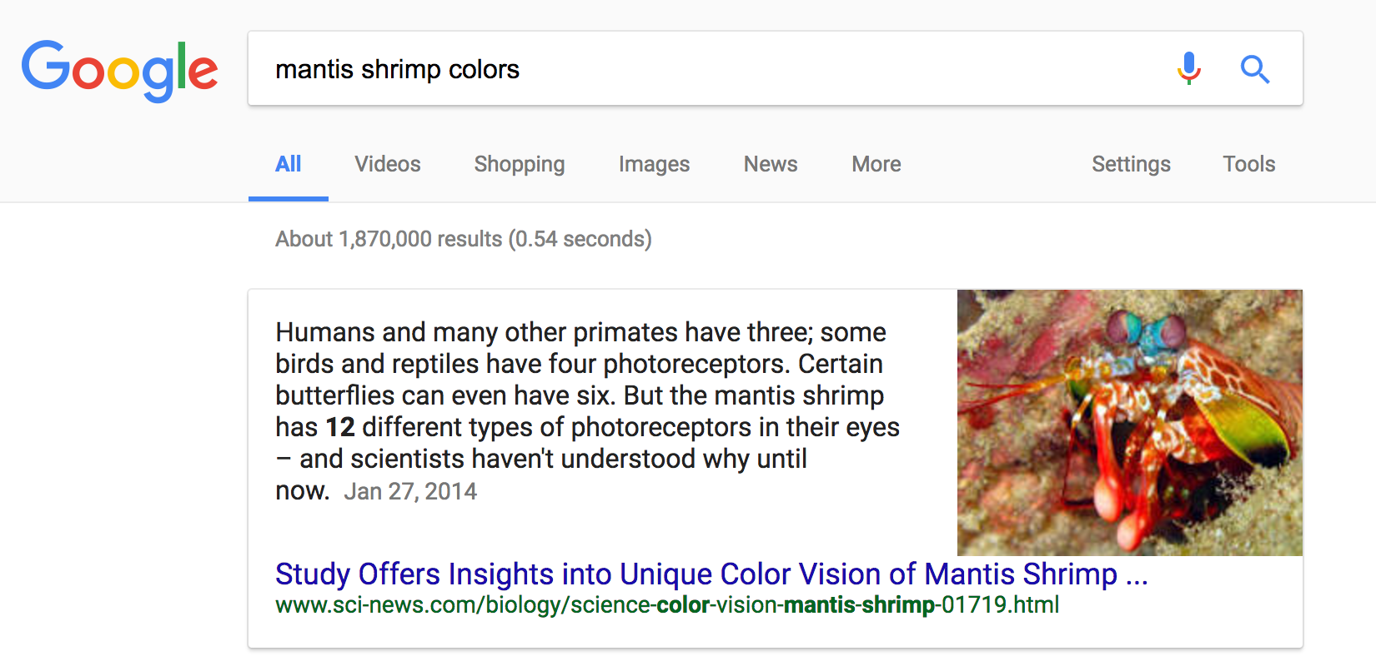
Why is this so fast?

Slide 50
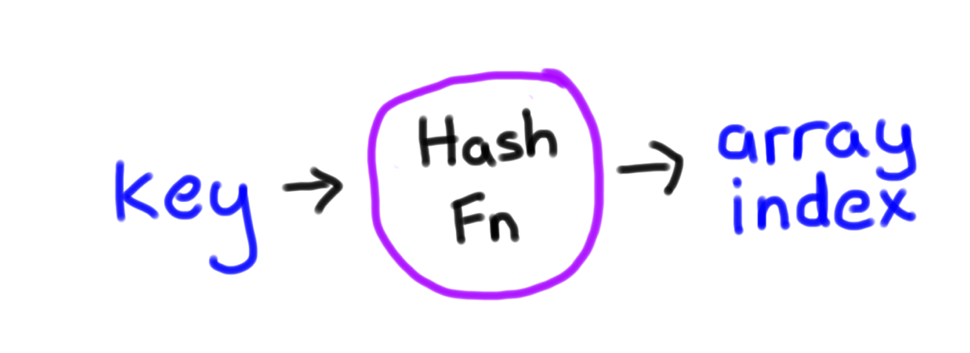
Why is this so fast?
int hash(string key);
* Learn more in CS106B

